Slide 1
Superheterodyne AM/ FM Receivers, Local Carrier Synchronization
Gaurav S. Kasbekar
Dept. of Electrical Engineering
IIT Bombay

Slide 2
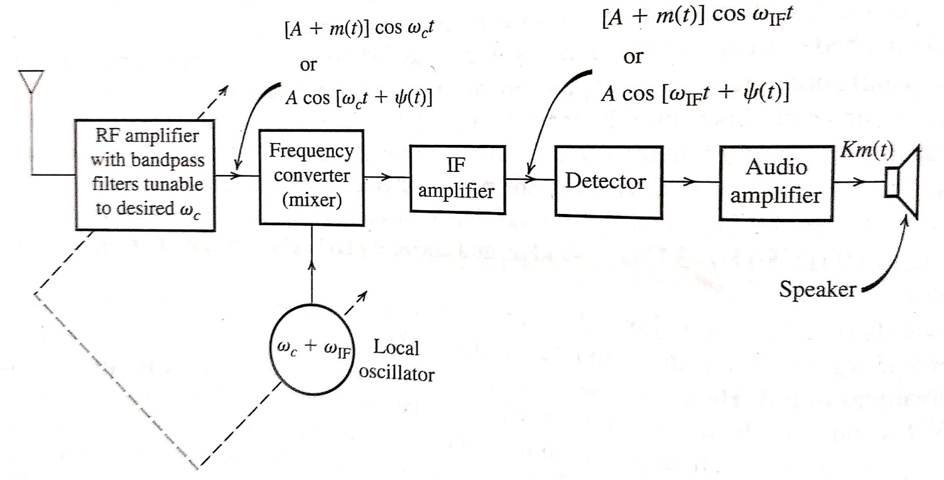
Superheterodyne AM/ FM Receivers
Radio receiver used in broadcast AM and FM systems called superheterodyne receiver
Consists of following components (see fig.):
RF (radio-frequency) section
Frequency converter (mixer)
IF (intermediate frequency) amplifier
AM or FM demodulator (detector)
Audio amplifier
Ref: B.P. Lathi, Z. Ding, “Modern Digital and Analog Communication Systems”, 4th ed.

Slide 3
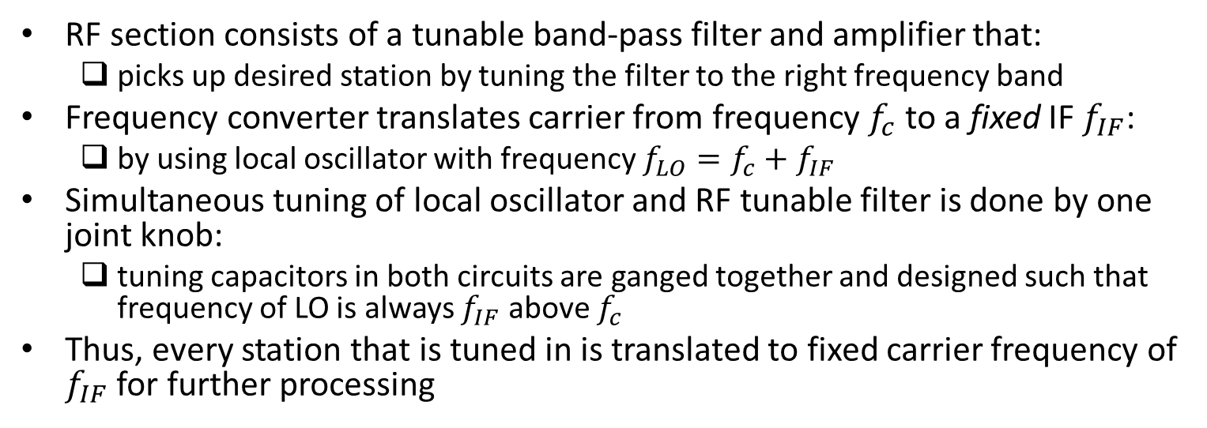
Superheterodyne AM/ FM Receivers (contd.)
RF section consists of a tunable band-pass filter and amplifier that:
picks up desired station by tuning the filter to the right frequency band
Frequency converter translates carrier from frequency $f_{c}$ to a fixed IF $f_{IF}$:
by using local oscillator with frequency $f_{LO}=f_{c}+f_{IF}$
Simultaneous tuning of local oscillator and RF tunable filter is done by one joint knob:
tuning capacitors in both circuits are ganged together and designed such that frequency of LO is always $f_{IF}$ above $f_{c}$
Thus, every station that is tuned in is translated to fixed carrier frequency of $f_{IF}$ for further processing
Ref: B.P. Lathi, Z. Ding, “Modern Digital and Analog Communication Systems”, 4th ed.

Slide 4
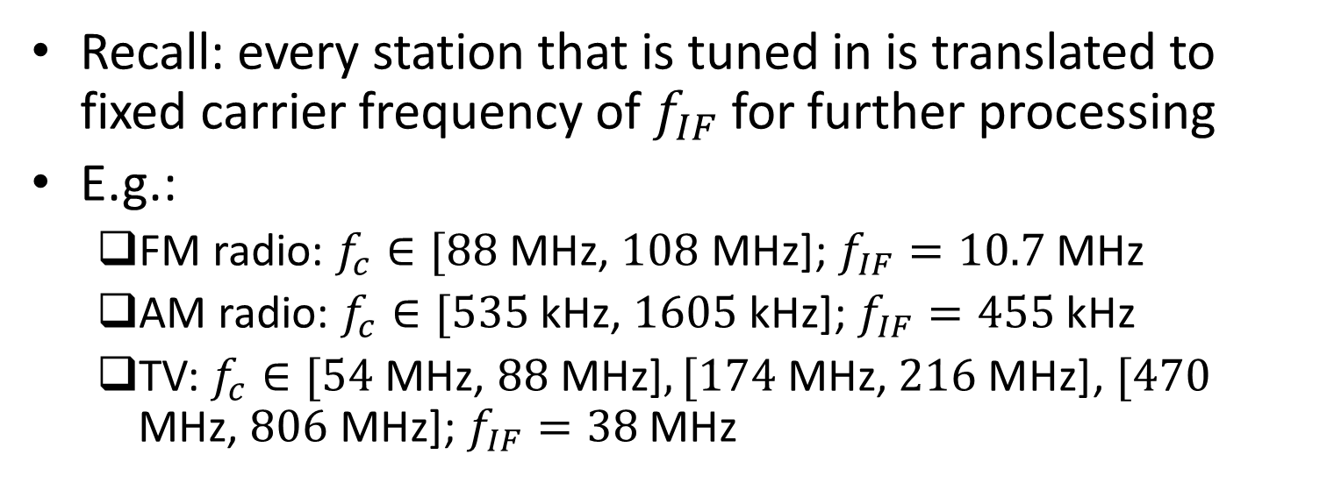
Superheterodyne AM/ FM Receivers (contd.)
Recall: every station that is tuned in is translated to fixed carrier frequency of $f_{IF}$ for further processing
E.g.:
FM radio: $f_{c}∈[88$ MHz, $108$ MHz]; $f_{IF}=10.7$ MHz
AM radio: $f_{c}∈[535$ kHz, $1605$ kHz]; $f_{IF}=455$ kHz
TV: $f_{c}∈[54$ MHz, $88$ MHz]$,[174 \text{MHz}\text{, }216 \text{MHz}\text{]}$, $[470$ MHz, $806$ MHz]; $f_{IF}=38$ MHz
Ref: B.P. Lathi, Z. Ding, “Modern Digital and Analog Communication Systems”, 4th ed.

Slide 5
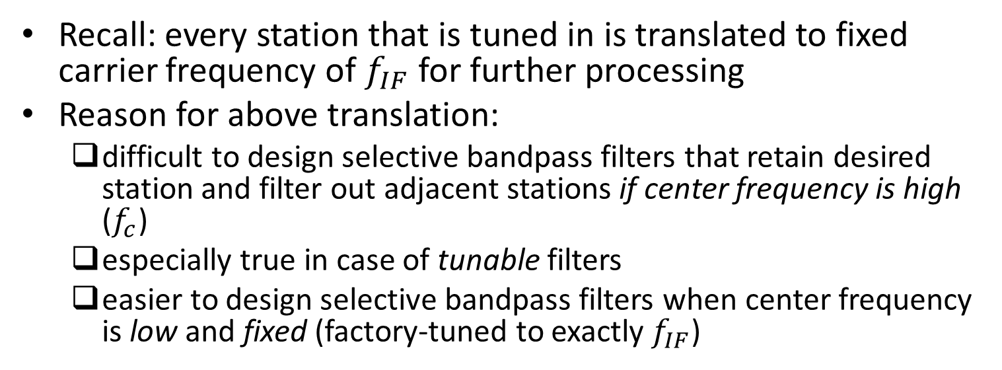
Superheterodyne AM/ FM Receivers (contd.)
Recall: every station that is tuned in is translated to fixed carrier frequency of $f_{IF}$ for further processing
Reason for above translation:
difficult to design selective bandpass filters that retain desired station and filter out adjacent stations if center frequency is high ($f_{c}$)
especially true in case of tunable filters
easier to design selective bandpass filters when center frequency is low and fixed (factory-tuned to exactly $f_{IF}$)
Ref: B.P. Lathi, Z. Ding, “Modern Digital and Analog Communication Systems”, 4th ed.

Slide 6
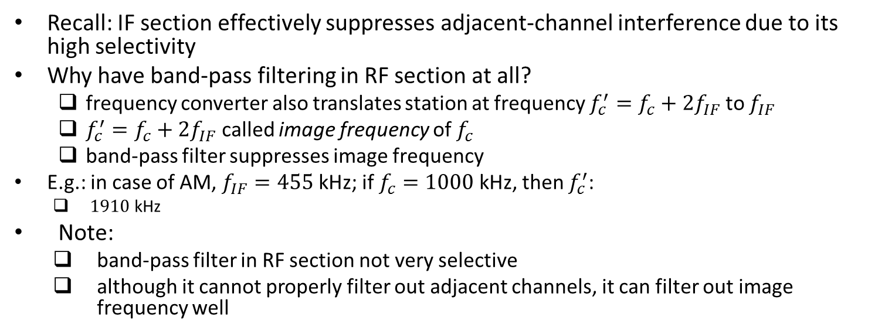
Superheterodyne AM/ FM Receivers (contd.)
Recall: IF section effectively suppresses adjacent-channel interference due to its high selectivity
Why have band-pass filtering in RF section at all?
frequency converter also translates station at frequency $f_{c}^{′}=f_{c}+2f_{IF}$ to $f_{IF}$
$f_{c}^{′}=f_{c}+2f_{IF}$ called image frequency of $f_{c}$
band-pass filter suppresses image frequency
E.g.: in case of AM, $f_{IF}=455$ kHz; if $f_{c}=1000$ kHz, then $f_{c}^{′}$:
$1910$ kHz
Note:
band-pass filter in RF section not very selective
although it cannot properly filter out adjacent channels, it can filter out image frequency well
Ref: B.P. Lathi, Z. Ding, “Modern Digital and Analog Communication Systems”, 4th ed.

Slide 7
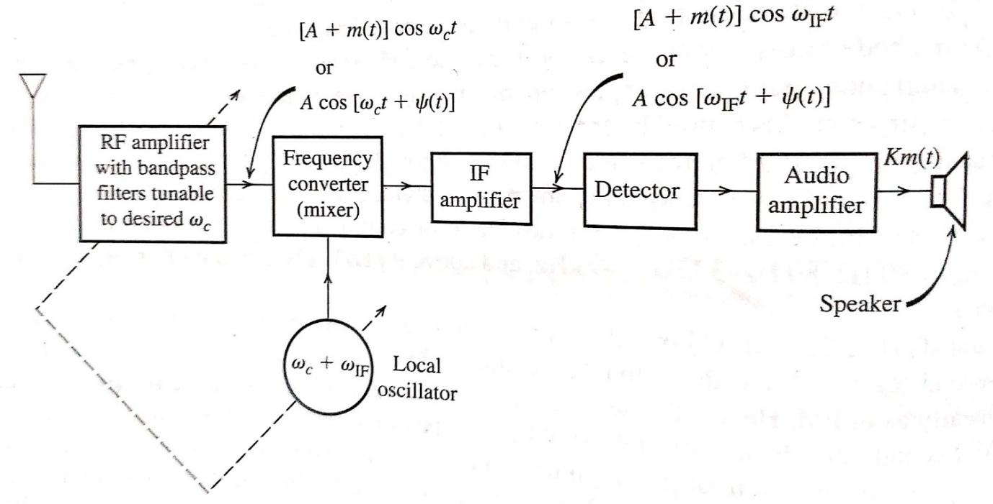
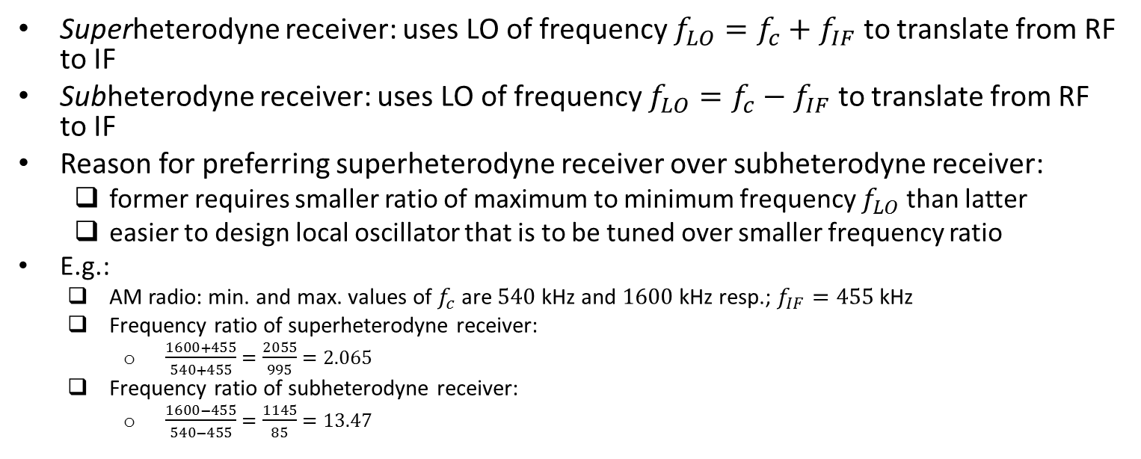
Superheterodyne AM/ FM Receivers (contd.)
Superheterodyne receiver: uses LO of frequency $f_{LO}=f_{c}+f_{IF}$ to translate from RF to IF
Subheterodyne receiver: uses LO of frequency $f_{LO}=f_{c}−f_{IF}$ to translate from RF to IF
Reason for preferring superheterodyne receiver over subheterodyne receiver:
former requires smaller ratio of maximum to minimum frequency $f_{LO}$ than latter
easier to design local oscillator that is to be tuned over smaller frequency ratio
E.g.:
AM radio: min. and max. values of $f_{c}$ are $540$ kHz and $1600$ kHz resp.; $f_{IF}=455$ kHz
Frequency ratio of superheterodyne receiver:
$\frac{1600+455}{540+455}=\frac{2055}{995}=2.065$
Frequency ratio of subheterodyne receiver:
$\frac{1600−455}{540−455}=\frac{1145}{85}=13.47$
Ref: B.P. Lathi, Z. Ding, “Modern Digital and Analog Communication Systems”, 4th ed.

Slide 8
Automatic Gain Control (AGC)
In general, signal strength of received AM signal varies dynamically due to time-varying nature of radio channels (fading)
So by default, volume of sound emitted by AM radio receiver would fluctuate with time
How can receiver compensate for this?
average voltage magnitude of output compared with reference level
signal amplified using a variable gain amplifier (VGA), whose gain is function of average voltage magnitude of output
Thus, VGA output is relatively constant
Above scheme called AGC
Ref: B.P. Lathi, Z. Ding, “Modern Digital and Analog Communication Systems”, 4th ed.

Slide 9
Homodyne Receiver
Also known as “zero-IF receiver” or “direct conversion receiver”
Modulated signal directly translated from carrier frequency to baseband
Band-pass filtering to remove adjacent channels and demodulation performed in baseband
Advantages:
simpler design than superheterodyne receiver; no need for IF stage
no need for image frequency suppression
Disadvantages:
envelope detection for AM or differentiation/ slope detection followed by envelope detection for FM cannot be performed
need to perform coherent demodulation, which is expensive

Slide 10
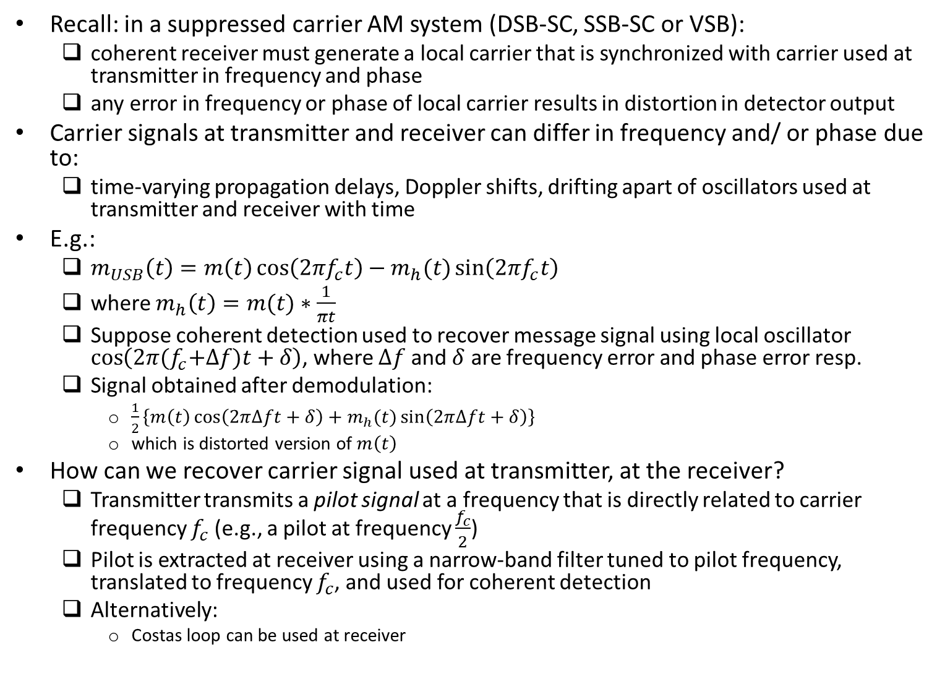
Local Carrier Synchronization
Recall: in a suppressed carrier AM system (DSB-SC, SSB-SC or VSB):
coherent receiver must generate a local carrier that is synchronized with carrier used at transmitter in frequency and phase
any error in frequency or phase of local carrier results in distortion in detector output
Carrier signals at transmitter and receiver can differ in frequency and/ or phase due to:
time-varying propagation delays, Doppler shifts, drifting apart of oscillators used at transmitter and receiver with time
E.g.:
$m_{USB}\left(t\right)=m\left(t\right)\cos\left(2πf_{c}t\right)−m_{h}(t)\sin\left(2πf_{c}t\right)$
where $m_{h}\left(t\right)=m(t)∗\frac{1}{πt}$
Suppose coherent detection used to recover message signal using local oscillator $\cos\left(2π{(f}_{c}+∆f)t+δ\right)$, where $∆f$ and $δ$ are frequency error and phase error resp.
Signal obtained after demodulation:
$\frac{1}{2}\left\{m\left(t\right)\cos\left(2π∆ft+δ\right)+m_{h}(t)\sin\left(2π∆ft+δ\right)\right\}$
which is distorted version of $m\left(t\right)$
How can we recover carrier signal used at transmitter, at the receiver?
Transmitter transmits a pilot signal at a frequency that is directly related to carrier frequency $f_{c}$ (e.g., a pilot at frequency $\frac{f_{c}}{2}$)
Pilot is extracted at receiver using a narrow-band filter tuned to pilot frequency, translated to frequency $f_{c}$, and used for coherent detection
Alternatively:
Costas loop can be used at receiver

Slide 11
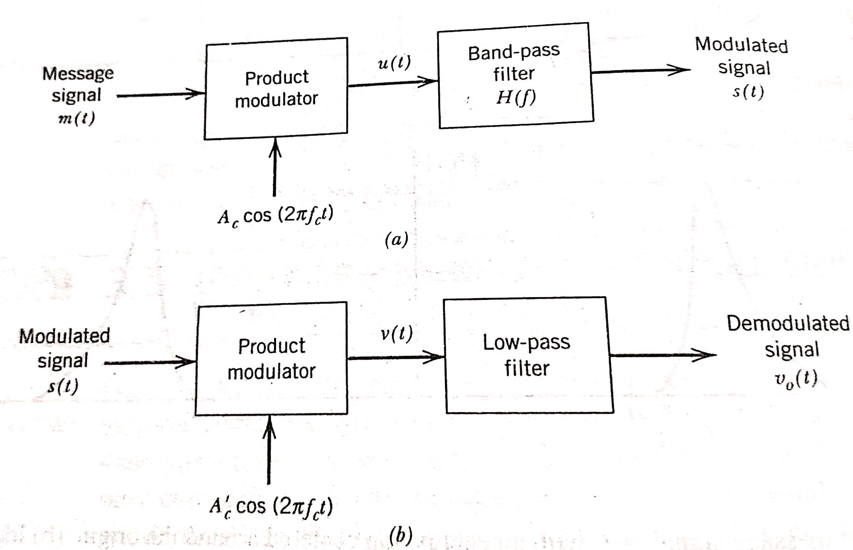
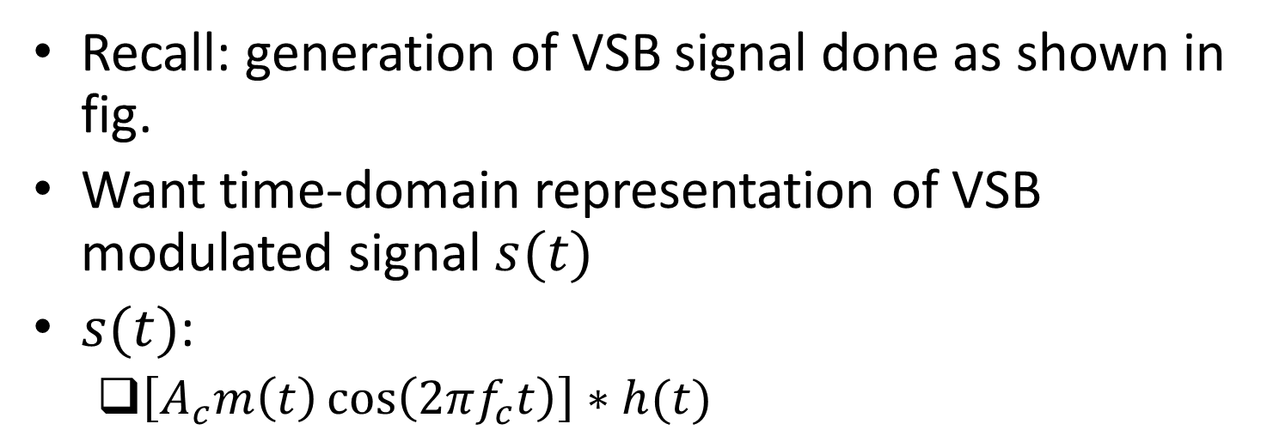
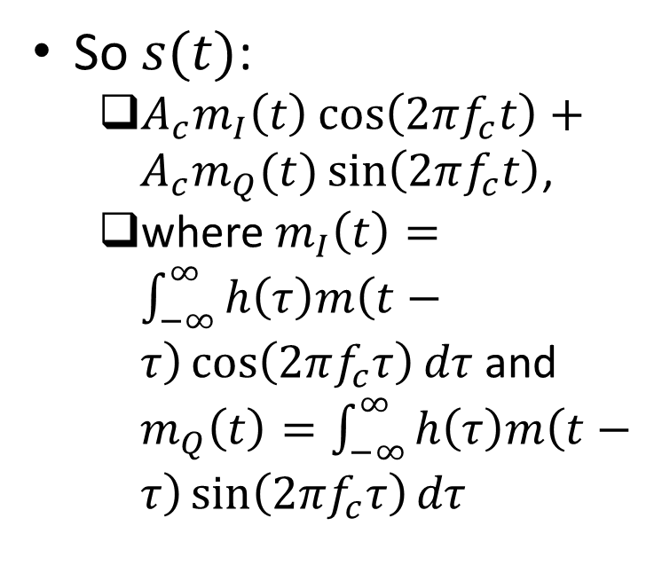
Time Domain Representation of VSB Signal
Recall: generation of VSB signal done as shown in fig.
Want time-domain representation of VSB modulated signal $s(t)$
$s(t)$:
$\left[A_{c}m\left(t\right)\cos\left(2πf_{c}t\right)\right]∗h(t)$
So $s(t)$:
$A_{c}m_{I}\left(t\right)\cos\left(2πf_{c}t\right)+A_{c}m_{Q}(t)\sin\left(2πf_{c}t\right)$,
where $m_{I}\left(t\right)=\int_{−∞}^{∞}{h\left(τ\right)m\left(t−τ\right)\cos\left(2πf_{c}τ\right)dτ}$ and $m_{Q}\left(t\right)=\int_{−∞}^{∞}{h\left(τ\right)m\left(t−τ\right)\sin\left(2πf_{c}τ\right)dτ}$
Ref: “Communication Systems” by S. Haykin and M. Moher, 5th ed

